Slide 1




DataVerse
Africa
Analyzing the Impact of Seasonal Income Fluctuations on Household Financial Stability in Rural Africa
Internship Presentation
Presented By:
GROUP 21
Babatunde Matthew Oladoyinbo
& Emmanuel Ene

Slide 2



01
Introduction
Uganda's rural economy is predominantly agrarian, with over 70% of the population dependent on agriculture for their livelihoods (World Bank, 2022). However, this reliance is characterized by significant income seasonality, driven by the cyclical nature of agricultural production. Most rural households earn the bulk of their income during harvest periods, while non-harvest months are marked by minimal or no earnings, resulting in highly uneven cash flows (FAO, 2021). This pattern contributes to widespread financial instability, limiting households' ability to manage essential expenditures or respond to unforeseen financial needs.
Rural financial markets in Uganda remain underdeveloped, with formal financial inclusion standing at just 10% in some regions, leaving the majority of smallholder farmers reliant on informal and often exploitative credit systems (FinScope Uganda, 2018). The absence of agricultural-specific financial products such as flexible savings accounts, crop-cycle-aligned credit, or income-smoothing mechanisms exacerbates households' vulnerability to common financial shocks—including medical emergencies, school fees, or adverse weather events (UNCDF, 2020).
This research therefore seeks to explore the structural gaps between rural income seasonality and the financial services landscape in Uganda. By identifying the limitations of current financial instruments and proposing adaptive, context-aware solutions, the study aims to contribute to the design of resilient rural financial ecosystems that promote stability, inclusion, and sustainable economic development.

Slide 3
02
Problem Statement
Uganda’s rural economy heavily relies on agriculture, with over 70% of the population engaged in farming. These farmers face seasonal income variations due to the reliance on crop harvests and livestock sales, leading to uneven cash flows throughout the year. During non-harvest periods, many households struggle to meet basic needs, causing financial instability. This cyclical nature of income is further exacerbated by a lack of tailored financial products, leaving households vulnerable to financial shocks, such as medical emergencies or school fees.

Slide 4
03
Project Objectives
The aim of this research is to explore the structural gaps between rural income seasonality and the financial services landscape in Uganda. And the specific objectives are:
Understand the extent to which seasonal income fluctuations influence household financial stability.
Analyze coping mechanisms used by households during periods of financial stress.
Assess the role of existing financial tools and products in mitigating these effects.
Design insights to recommend innovative financial solutions tailored for rural households experiencing seasonal income variations.

Slide 5

04
Data Overview
Two Dataset were used for this project i.e. Seasonal income and Expenditure dataset and the Household Stability dataset which contains the target feature for this project.
1. Seasonal Income & Expenditure Dataset
Observations: 24,000 monthly records
Variables: 13, including Crop_Income, Livestock_Income, Off_Farm_Income, Total_Income, Total_Expenses, and Season
Scope: Captures seasonal income patterns and household spending across multiple months in a period of 2 years (a pseudo year was employed for analysis on BI i.e. 2023 and 2024).
2. Household Stability Dataset
Observations: 1,000 households
Variables: 24, including Location, Education_Level, Employment_Type, Distance_to_Bank_km, and Financial_Stress_Score
Scope: Measures socio-economic conditions and coping mechanisms at the household level
MISSION

Slide 6
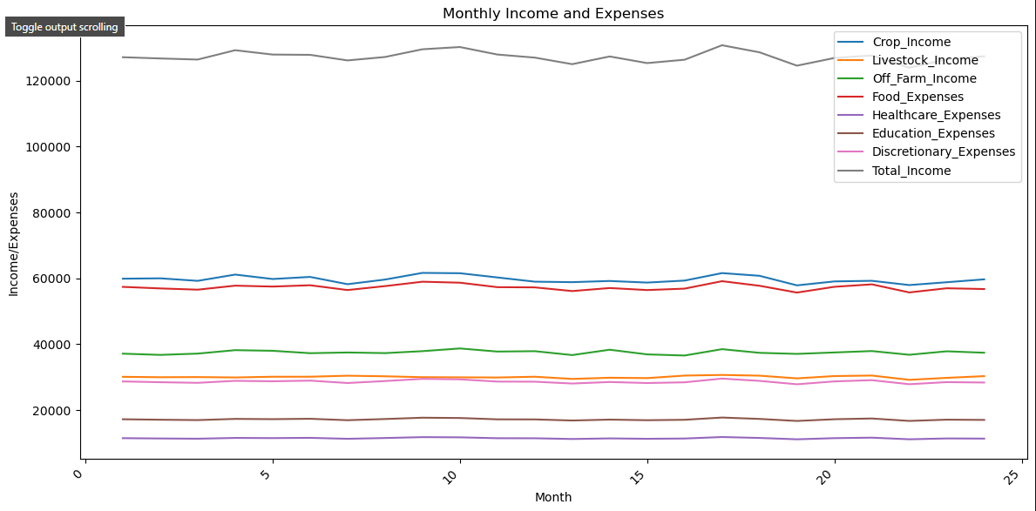
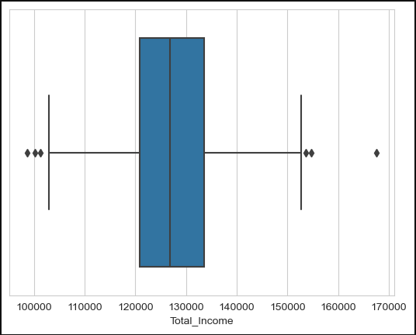
05
EDA(1)
MISSION
Key Insights
Having established that majority of their Total income is from Crop Income, we used that and the outliers to pick households that are doing relatively well and households that are worst, in order to map their character.

Slide 7
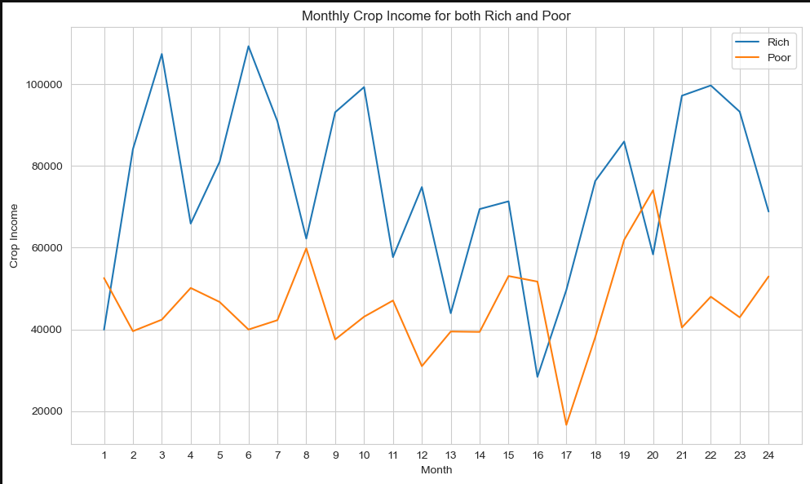
05
EDA(1)
Key Insights
Overall, the poor experienced a more stable income fluctuation than the rich who experienced a more fluctuating income over the 24 months.
For the first 12 months, the Poor and the Rich class experience complete opposite Harvesting and Non-Harvesting periods which could be due to other factors like variation in crop planted and method of planting, weather etc.
For the second 12 months, both classes experienced the same pattern but with the Rich class with 1 month lagging. This pointing the possibility of planting same time crop but the Rich class seems to about UGX 20,000 more than the Poor.
MISSION

Slide 8
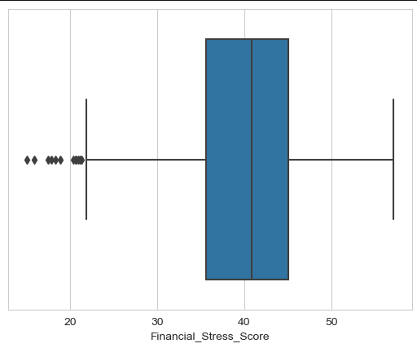
05
EDA(2)
Observations
Based on the Financial Stress Score of the Households, again we see some households that experience little stress relative to others. Getting to know their Financial skills and Coping mechanism could help other households too.
So we class households into least stressed and most stressed.
MISSION

Slide 9
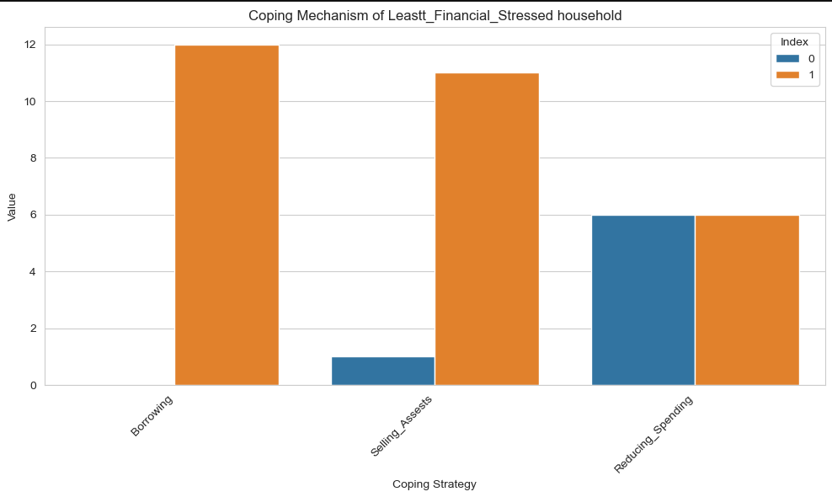
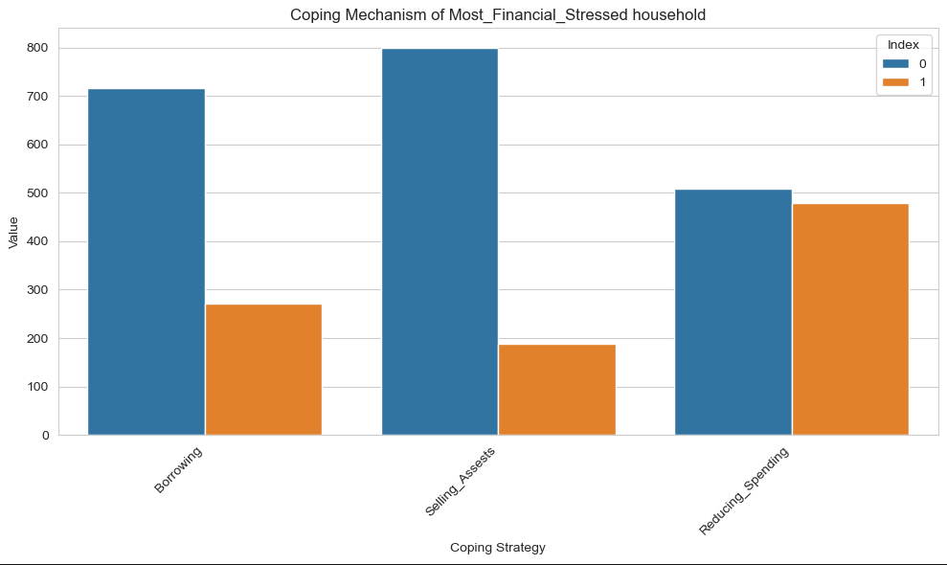
05
EDA(2)
MISSION
Key Observations
Coping mechanism engaged by the least financially stressed households include Borrowing, Selling Asset and Reduced Spending.
Recommendation
The highly affected households are advised to follow the coping mechanism of the least affected households

Slide 10
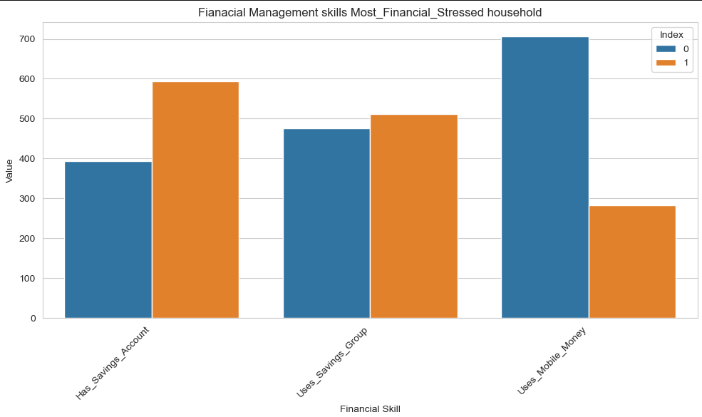
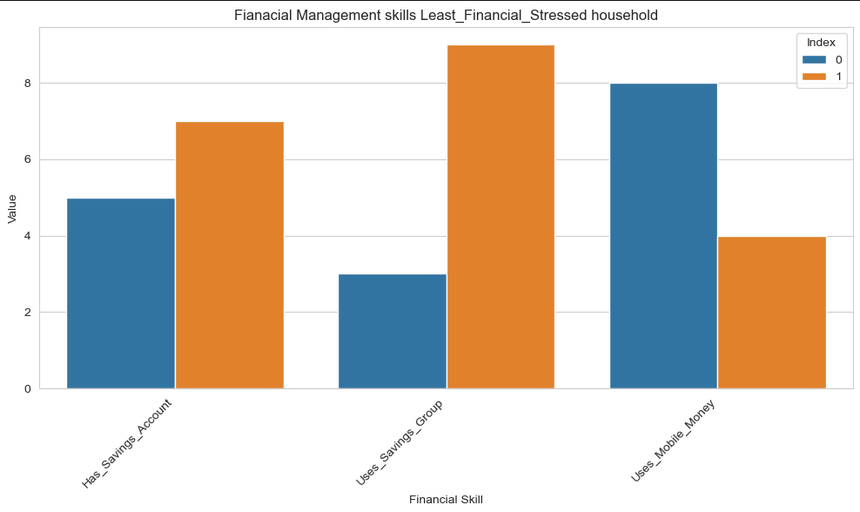
05
EDA(2)
MISSION
Key Observations
Both classes have similar financial management skills, have savings account, uses saving groups and don't use mobile money

Slide 11
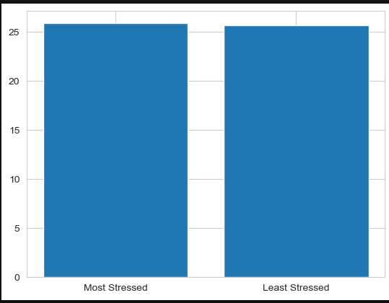
05
EDA(2)
Key Observations
Buttressing the previous slide observation, distance to Banking facilities does not seem to be a major contributor to Financial stress level since both classes relative percentage doesn’t use Mobile Banking
MISSION

Slide 12
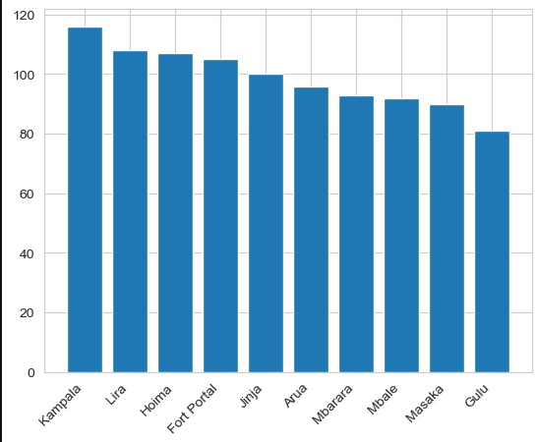
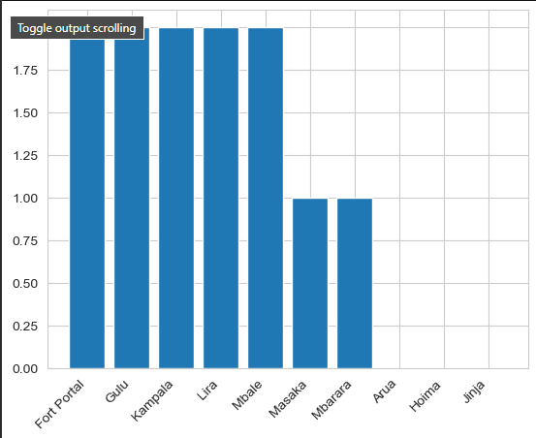
05
EDA(2)
Most Stressed Households
Least Stressed Households
MISSION
Key Observations
Could be to other factors like access to market, fertile soil and co as least stressed households are not in Arura and Hoima

Slide 13
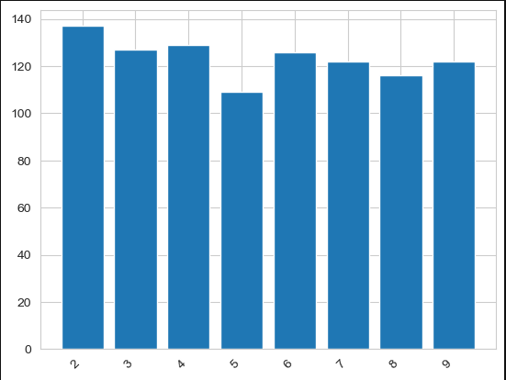
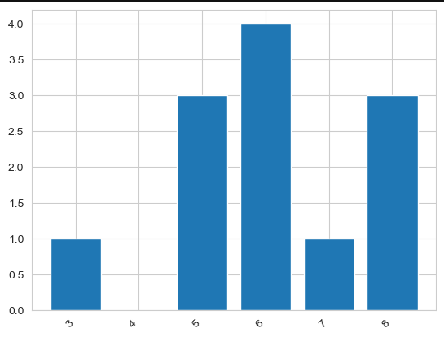
05
EDA(2)
Most Stressed Households
Least Stressed Households
MISSION
Key Observations
Majority of the Least stressed have more large family which points to the possibility of man power and labor on farm.

Slide 14
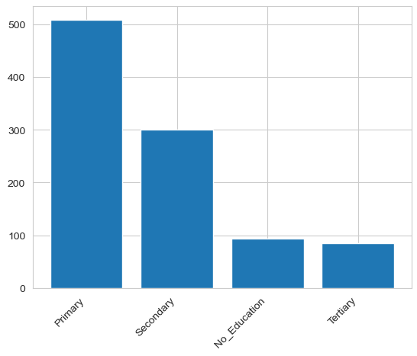
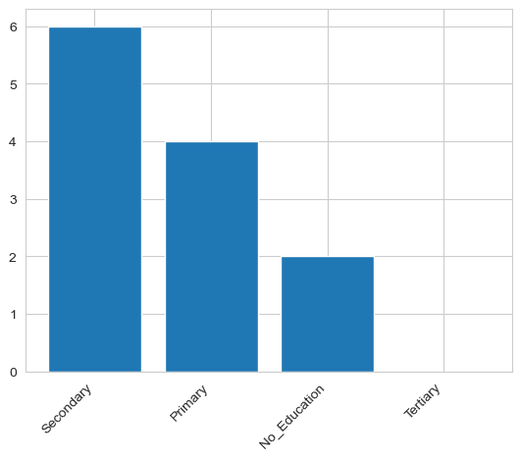
05
EDA(2)
Most Stressed Households
Least Stressed Households
MISSION
Key Observations
Level of education could be an added advantage in the farming business

Slide 15
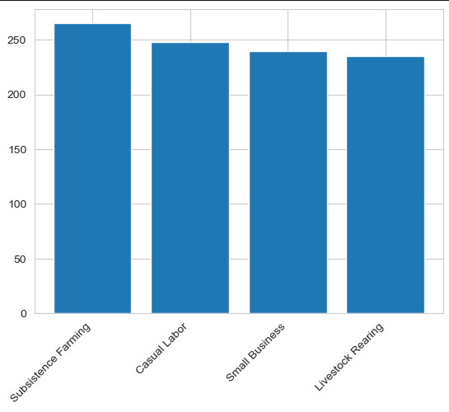
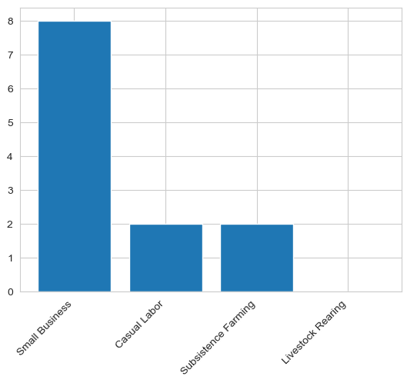
05
EDA(2)
Most Stressed Households
Least Stressed Households
MISSION
Key Observations
Being into small business could make a farmer afford more time for his farm

Slide 16
05
DASHBOARD
MISSION

Slide 17
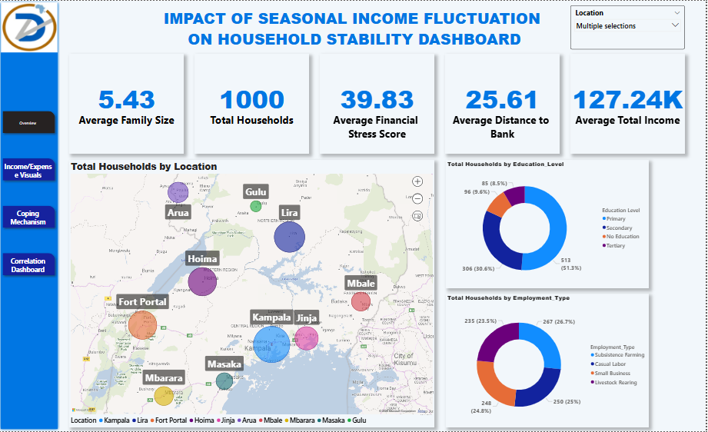
05
Data Insight(1)
Key Insights
High Financial Stress: Households face notable strain (avg. score: 39.83) due to irregular income and low liquidity.
Access Gaps: Long distances to banks (avg. 25.61 km) limit financial inclusion, especially in rural areas.
Low Education Levels: Over half of households have only primary education, limiting financial resilience.
Agriculture Reliance: 50.5% depend on subsistence farming/livestock, worsening income seasonality.
Nationwide Concern: Challenges span multiple towns, showing this is a widespread issue.
Unstable Income: Average income (UGX 127.24K) appears unstable and misaligned with household needs.
MISSION

Slide 18
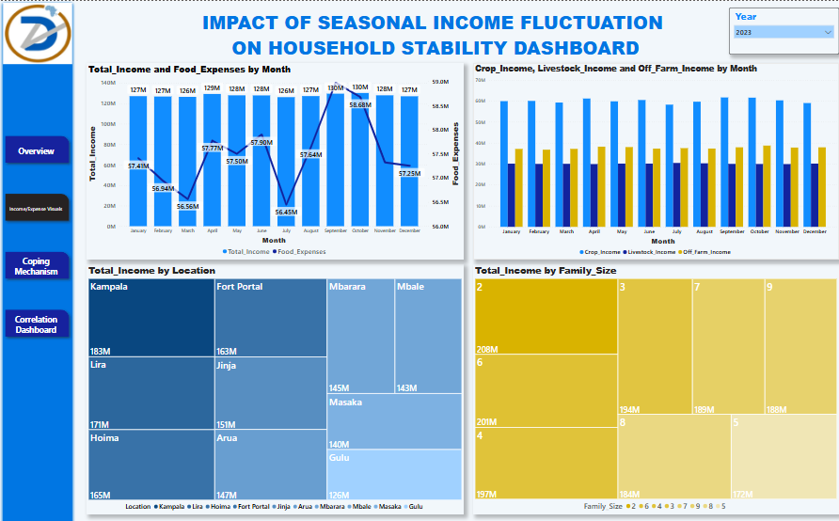
06
Data Insight(2)
Key Insights
Seasonal Fluctuation: Income peaks in August–October (avg. UGX 130M), with sharp dips mid-year, highlighting seasonal instability.
Food Expense Mismatch: Expenses spike even when income is low, indicating vulnerability in budgeting and food security.
Income Sources: Crop income dominates, but livestock and off-farm incomes remain stable and underutilized.
Location Gaps: Kampala and Lira lead in income; others like Gulu and Masaka lag, showing regional income disparity.
Family Size Impact: Larger families (6–9 members) show higher income, hinting at labor-driven earnings but also possible strain.
MISSION

Slide 19
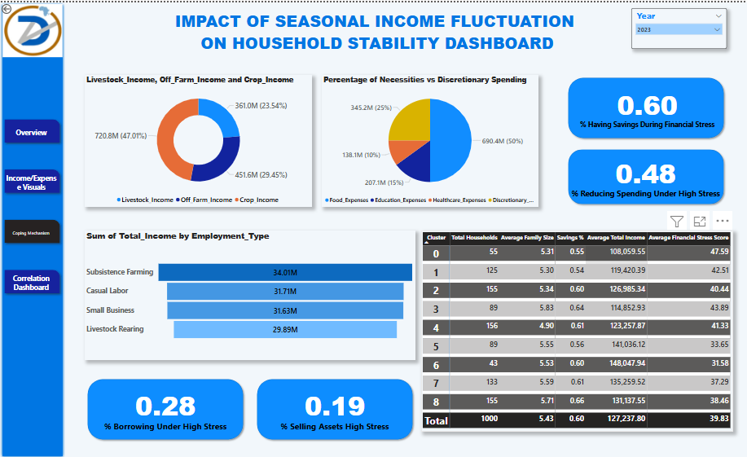
07
Data Insight(3)
Key Insights
Savings as Buffer: 60% of households rely on savings during financial stress—indicating moderate financial preparedness.
Reduced Spending Strategy: 48% reduce expenses under pressure, signaling limited coping options beyond income.
Borrowing & Selling Assets: Only 28% borrow and 19% sell assets under stress—possibly due to limited access to credit or fear of asset depletion.
Income Dependence: Livestock income dominates (47%), while crop and off-farm sources contribute 29% and 24% respectively.
Employment Type Vulnerability: Subsistence farmers and casual laborers earn less (~UGX 31M–34M), making them highly susceptible to shocks.
Cluster Analysis: Clusters 0 and 2 face the highest financial stress (avg. scores 47.59 & 40.44), with low savings and income levels.
MISSION

Slide 20
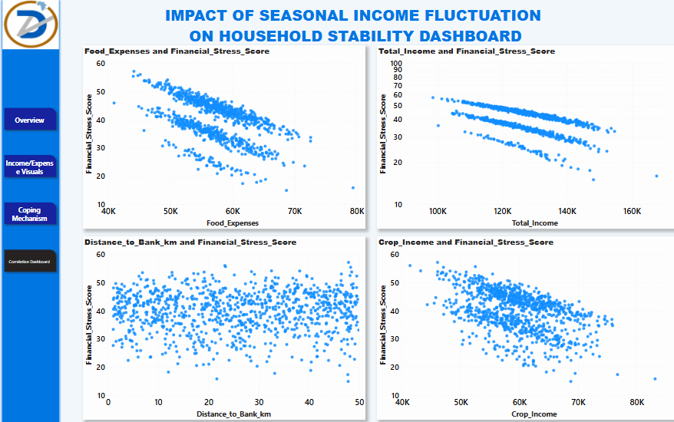
07
Data Insight(4)
Key Insights
Inverse Correlation Between Expenses and Stress: Households with higher food expenses tend to report lower financial stress, possibly indicating that greater food spending correlates with higher disposable income or stability.
There is a clear negative correlation between total income and financial stress score. As income increases, stress levels decrease—underlining income as a strong stabilizer.
A rise in crop income correlates with lower stress levels, emphasizing the importance of agricultural earnings in managing financial uncertainty, especially in rural settings.
Bank Proximity Not a Major Factor: The distance to the nearest bank does not significantly impact financial stress, indicating that either households have adapted alternative financial access methods (like mobile money or savings groups), or that proximity to formal institutions isn't the main constraint.
MISSION

Slide 21
05
PREDICTIVE MODELLING
MISSION

Slide 22
05
PREDICTIVE MODELLING
In order to further achieve a future saving solution, a predictive model was trained with the Financial Dataset of the households provided.
Predicting the Financial Stress Score of the Household so that they can prepare and work towards a preventive measure.
A LinearRegression model was trained and a R-Squared value of 98.7% and a MSE of 0.55.
Further attempt was made and another model was trained, OLS Regression model and an R-Squared value of 99.1% was achieved which was used as our final model and deployed.
MISSION

Slide 23
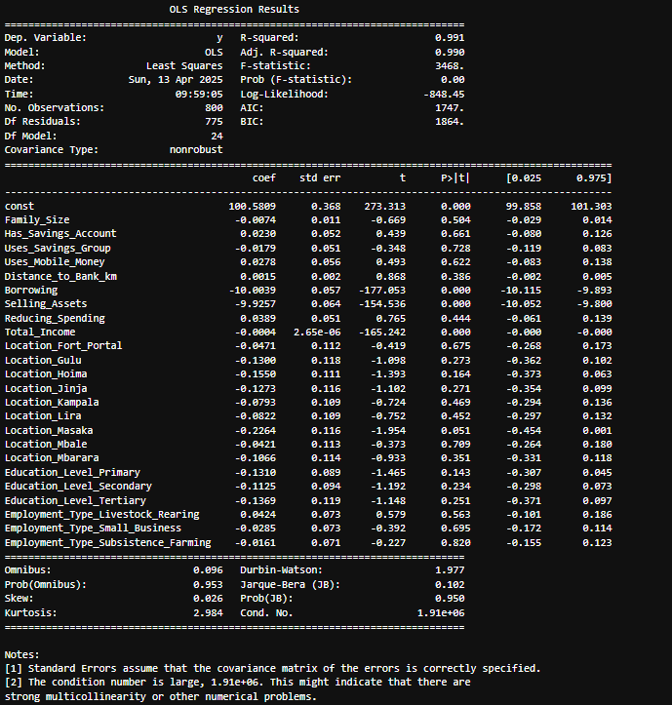
PREDICTIVE MODELLING
05
MISSION

Slide 24
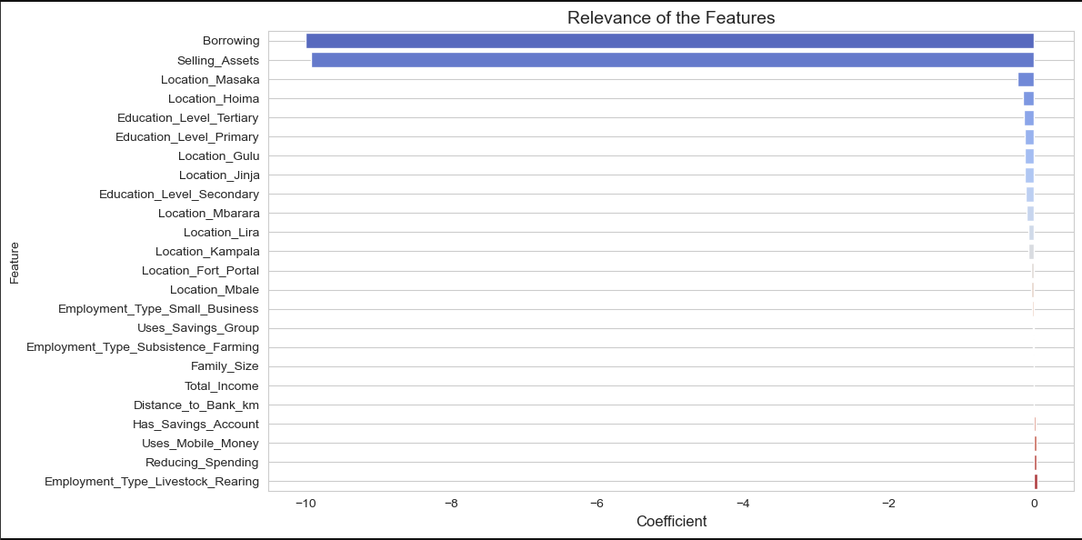
PREDICTIVE MODELLING
05
Feature Importance
MISSION

Slide 25
PREDICTIVE MODELLING
05
Model Deployed with Streamlit
MISSION

Slide 26

04
Recommendation
Based on the findings, provide recommendations for addressing the problem
Short-term recommendations
Long-term recommendations

Slide 27

05
Implementation Plan
Outline the steps for implementing the recommendations
Timeline
Resources required
Key stakeholders

Slide 28
06
Conclusion
Summarize the key takeaways from the project
Image: A relevant image or logo

Slide 29
07
References
Outline the steps for implementing the recommendations
Timeline
Resources required
Key stakeholders

Slide 30
08
Appendix (Optional)
Additional information that supports the presentation, but is not essential for the main message.

Slide 31

DataVerse
Africa
Thank You
Internship Presentation

